Slide 1
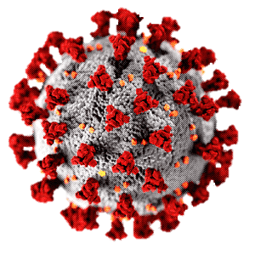
In-depth analysis of COVID-19 transmission dynamics and containment measures
PRESENTING BY,
Nandhini V

Slide 2
Covid is the world’s deadliest pandemic in last 100 years Covid is 7th deadliest pandemic in the history.

Slide 3
January of 2022 reported 4 million+ cases in a single day

Slide 4
January 2022 wave
registered more
cases but was NOT very deadly.
Early days of Covid
were very deadly.

Slide 5
Vaccination efforts
from mid-2021
reduced the death rate.

Slide 6
High Income Group
has very high
Spread.
This can be because of low
quality data collection in
other income groups

Slide 7
North America & South America had lesser Spread but a very high death rate.
This can be because of low quality data collection in other continents.

Slide 8
United States did not
manage the spread on
Covid Properly.
This can be because of low
quality data collection in other
countries

Slide 9
Most Countries has lower spread level.

Slide 10
High GDP does not mean low spread.

Slide 11
High GDP does not mean low Death Rate.

Slide 12
Thank You

